Slide 1

MRSP Project Group 8
Group Members:
Farzeel Aftab
Tatiana Merkulova
Aftab Arshad Muhammad Jawad Asghar

Slide 2
Task 1
Audio Data
24-bit, 44100 kHz sound files
Dataset
5 original audio files
15 derivative audio files across 3 acoustic environments: Opera Hall, Reverberation Hall, Small Office
Software Used
Free Sound
Audacity

Slide 3
Task 2
Objective
Analyze and compare perceived quality of audio files after applying two compression methods: Uniform Quantization and AAC Encoding.
Compression Methods:
Uniform Quantization
Divides continuous range of amplitudes into finite levels.
Reduces bit depth, leading to compression.
AAC Encoding
Advanced Audio Coding with better sound quality than MP3 at similar bit rates.
Utilizes perceptual noise shaping and predictive coding.

Slide 4
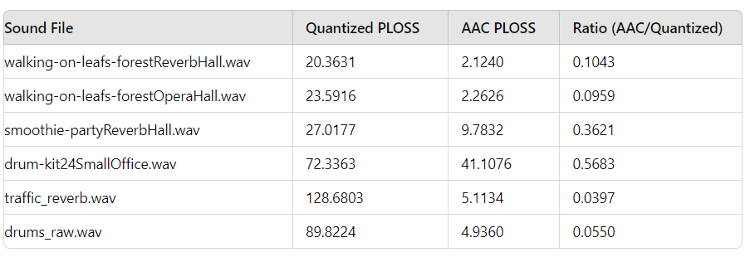
Perceived Quality Loss - Results Overview
Measured for both Quantization and AAC Encoding.

Slide 5
Key Findings:
Quantization results in higher perceived loss than AAC encoding in most cases.
AAC consistently maintains better sound quality (Ratio < 1).
Observations by Genre:
Walking on Leafs:
AAC shows significantly lower PLOSS values compared to Quantization.
Ratio ranges from 0.0959 to 0.1101.
Smoothie:
Mixed results; some files show higher PLOSS with AAC.
Ratios up to 1.2292, indicating higher perceived loss in some cases.

Slide 6
Observations by Genre: (continue)
Drum Kit & Traffic::
AAC consistently outperforms Quantization
Significantly lower PLOSS values, e.g., Drum Kit (Ratio 0.0874 - 0.6366),
Traffic (Ratio 0.0351 - 1.0165)
Drums:
AAC better preserves sound quality.
Ratios range from 0.0280 to 0.0540

Slide 7
Conclusion
Overall Analysis:
Quantization leads to greater perceived loss compared to AAC.
Ratios (AAC/Quantized) < 1 for most audio files, highlighting AAC’s effectiveness
Genre-Specific Observations:
"Smoothie" genre exhibits higher perceived loss with AAC in some cases..
"Drum Kit," "Traffic," and "Drums" genres show AAC significantly outperforms Quantization.

Slide 8
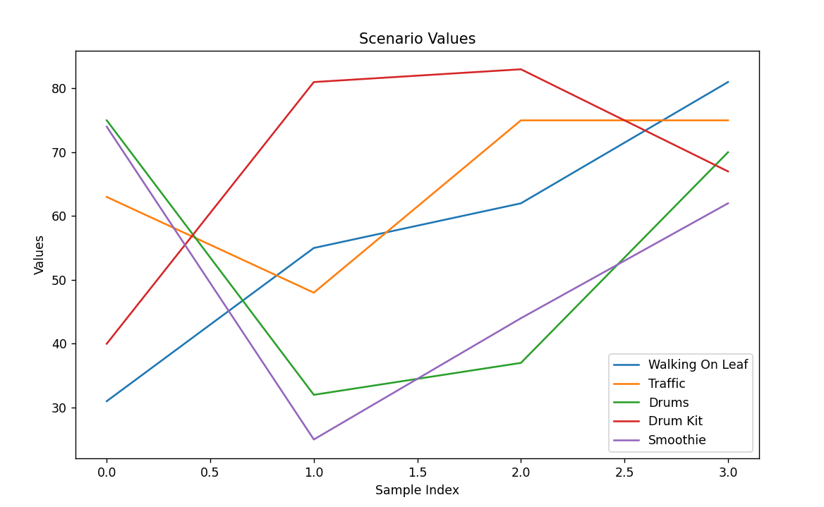
Result Graphs plotted using the results from the MUSHRA Test.

